Slide 1



Generating AR/VR visualisation from textual description of numerical data
Group ID: 7
Group Members:
Prachi Gandhi - 16010422233
Chandana Galgali - 16010422234
Mahek Thakkar - 16010422235
Harsh Singwi - 16010422241
Guide Details:
Name: Avani Sakhapara
Department: Information Technology

Slide 2
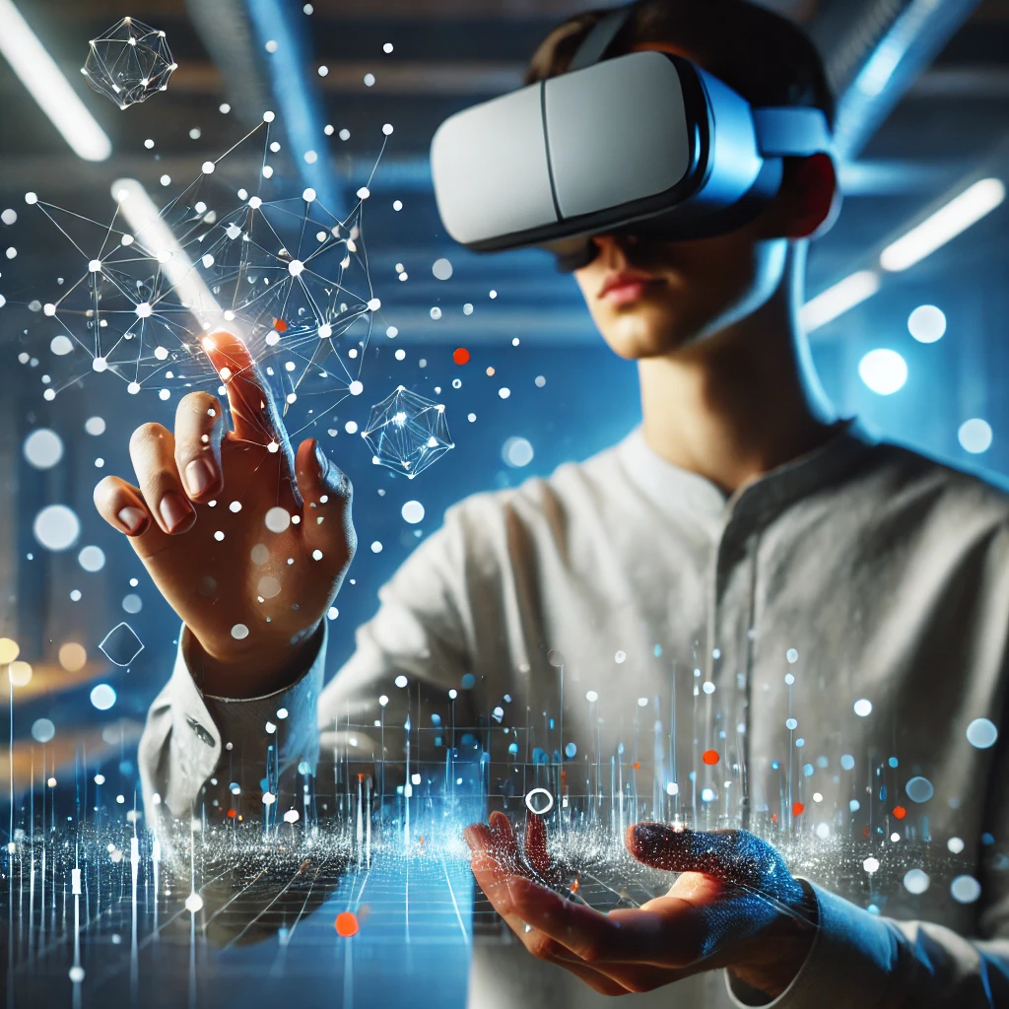
The Need for Interactive Data Visualization in AR/VR
Traditional 2D visualizations limit depth and interactivity
Virtual Reality enables 3D exploration with zoom, rotate, and pan
Augmented Reality displays static 3D charts in real-world view
Enhances data understanding and pattern recognition

Slide 3

Problem Definition
Develop a system that transforms textual descriptions of numerical data into suitable visualizations, which are then rendered in an immersive Augmented Reality and Virtual Reality environments for interactive exploration.

Slide 4
Background Work / Literature Survey
Conversion of text into table/images/videos
Processing techniques for text
Table to visualisation

Slide 5
Background Work / Literature Survey
Text to Table using LLMs
Year | Publication (IEEE/Journal) | What is the paper about? (Aspects) | Methodology (Steps in 2-3 lines) | Datasets (Size, Type, etc.) | Results (Validation Metrics) | Advantages | Limitations | Reference No.
2024 | ACM International Conference on Information and Knowledge Management (CIKM 2024) | This paper introduces Revilio, a system that uses large language models to reconstruct tables from free-form text, especially when column boundaries are lost. It addresses challenges like ensuring semantic and syntactic consistency in table generation. | The system first detects headers from text, generates a table sketch using an LLM, and then refines the table using a "generate-and-rank" strategy to ensure syntactic and semantic consistency. | The paper evaluates Revilio on multiple datasets, including those containing tables with over 100,000 rows. | The system outperforms traditional methods with an accuracy improvement of 5.8–11.3% over neural and symbolic baselines. | It can handle large tables effectively and improves table reconstruction accuracy. | The system is primarily designed for scenarios where table column boundaries are lost and may not generalize well to other types of text-to-table conversion tasks. | [1]
2024 | arXiv preprint arXiv:2403.14457 | This paper presents a two-stage approach to converting unstructured text into structured tables. It uses a model that generates table structures (headers) and content by asking questions. | First, the system generates the table structure (headers) from text using conditional text generation. Then, it formulates questions based on these headers and uses an LLM to answer them, filling the table with appropriate content. | The paper evaluates on datasets like E2E, WikiTableText, and WikiBio, among others. | Achieved up to 20% improvement in BERTScores for table content generation tasks compared to previous methods. | The approach ensures syntactically valid tables and can utilize large pre-trained models in a zero-shot configuration, which is beneficial for many real-world applications. | The model requires high-quality training data and fine-tuning to achieve optimal results, which can be resource-intensive. | [2]
2024 | Proceedings of the Association for Computational Linguistics (ACL 2024) | This paper explores how large language models (LLMs), such as GPT-3, can be used for the text-to-table task without fine-tuning on specific datasets. It evaluates how LLMs can generalize across various input texts and generate valid tables. | LLMs are prompted to generate tables from unstructured text, and the task is evaluated on multiple datasets using zero-shot and few-shot learning techniques. | Datasets like E2E, WikiTableText, and WikiBio are used for evaluation, focusing on different types of text-to-table conversion tasks. | The approach demonstrates the capability to generalize well across various datasets, with improvements in output quality compared to previous fine-tuned models. | No need for extensive fine-tuning or specific schema design, making it adaptable to various text formats and datasets. | Performance can be inconsistent depending on the complexity and type of text, as LLMs may struggle with non-standard or highly structured data. | [3]
2024 | VLDB/NeurIPS | Examines how LLMs can generate SQL queries from natural language text using retrieval-augmented generation (RAG). | Implements prompting techniques and fine-tuning on domain-specific tables to improve SQL accuracy. | TabFact, Spider (large-scale tabular question-answering datasets). | Fine-tuned models improve SQL accuracy over zero-shot approaches. | LLMs can generalize across domains. | Requires high computational resources; struggles with complex queries​ | [4]

Slide 6
Background Work / Literature Survey
Text to Table using seq2seq model
Year | Publication (IEEE/Journal) | What is the paper about? (Aspects) | Methodology (Steps in 2-3 lines) | Datasets (Size, Type, etc.) | Results (Validation Metrics) | Advantages | Limitations | Reference No.
2022 | ACL | Proposes converting unstructured text to structured tables using seq2seq models. | Uses fine-tuned seq2seq models with table constraint and relation embeddings to extract structured data. | Rotowire, E2E, WikiTableText, WikiBio (various sizes, sports, Wikipedia, open-domain tables). | Seq2seq models outperform RE/NER models; BART-large improves extraction accuracy. | No need for predefined schemas; works on long texts. | Struggles with text diversity, reasoning, and large tables​ | [5]
Table to Text
Year | Publication (IEEE/Journal) | What is the paper about? (Aspects) | Methodology (Steps in 2-3 lines) | Datasets (Size, Type, etc.) | Results (Validation Metrics) | Advantages | Limitations | Reference No.
2023 | IEEE/Scientific NLP Conference | Focuses on controlled text generation from tabular data with a scientific reasoning component. | Introduces CTRLSciTab dataset and uses a retriever-generator model with external domain-specific knowledge. | CTRLSciTab (8,967 table-description pairs with scientific knowledge). | CTRLSciTabNet (Bart) outperforms GPT-3.5, improving fluency and factuality. | Uses domain-specific knowledge for improved accuracy. | Struggles with hallucination and aligning generated text with scientific facts​ | [6]
Extracting Information from Text
Year | Publication (IEEE/Journal) | What is the paper about? (Aspects) | Methodology (Steps in 2-3 lines) | Datasets (Size, Type, etc.) | Results (Validation Metrics) | Advantages | Limitations | Reference No.
2023 | Contemporary Accounting Research, Wiley | FinBERT is a domain-specific adaptation of BERT for financial text analysis. It is trained on financial reports, earnings calls, and analyst reports to enhance sentiment classification and financial text understanding. | 1. Pretrained on a large corpus of financial documents (SEC filings, earnings calls, analyst reports). 2. Fine-tuned on sentiment classification and ESG-related discussions. 3. Compared against traditional ML models (SVM, RF, LSTM, CNN) and general BERT. | Financial filings (SEC 10-K, 10-Q), analyst reports, and 136,578 earnings call transcripts. Total dataset size: 4.9 billion tokens. | Achieved 88.2% sentiment classification accuracy (higher than LSTM, CNN, and traditional methods). Outperformed BERT in financial text classification, especially with small training samples. | 1. Improves financial sentiment classification accuracy. 2. Works well with small training datasets. 3. Outperforms traditional ML models and even general BERT for finance applications. | FinBERT, like other deep learning models, lacks interpretability, making its decision process opaque—a key challenge in finance where transparency is crucial. | [7]

Slide 7
Background Work / Literature Survey
Processing Techniques for Text
Year | Publication (IEEE/Journal) | What is the paper about? (Aspects) | Methodology (Steps in 2-3 lines) | Datasets (Size, Type, etc.) | Results (Validation Metrics) | Advantages | Limitations | Reference No.
2022 | Journal of Big Data | This paper evaluates the effectiveness of BERT embeddings in text clustering tasks, comparing them with traditional TF-IDF representations. | The study applies BERT to generate text embeddings and compares clustering performance using algorithms like k-means and deep embedded clustering | Utilized three popular text clustering datasets: AG News, DBpedia, and 20 Newsgroups. | BERT-based representations outperformed TF-IDF in 28 out of 36 metrics, including clustering accuracy (ACC), normalized mutual information (NMI), and adjusted rand index (ARI). | BERT captures contextual information, leading to improved clustering performance | The study focuses on unsupervised learning; results may vary with different clustering algorithms. | [8]
2023 | IEEE Access | This survey provides a comprehensive overview of text representation methods in NLP, from early techniques to advanced embeddings. | The paper reviews various text representation techniques, discussing their evolution, applications, and performance in NLP tasks. | Not applicable (survey paper). | Not applicable (survey paper). | Offers a detailed understanding of the progression and applications of text representation techniques. | As a survey, it doesn't provide experimental validations or comparisons. | [9]
2020 | IEEE Transactions on Knowledge and Data Engineering | This review focuses on graph-based methods for text representation and matching, discussing their applications and future research directions. | The paper analyzes various graph-based text representation techniques, their methodologies, and effectiveness in tasks like text matching and retrieval. | Not applicable (review paper). | Not applicable (review paper). | Highlights the potential of graph-based representations in capturing complex relationships in text. | Lacks experimental comparisons; primarily theoretical analysis. | [10]
2023 | arXiv preprint | This paper explores challenges and trends in representing and querying knowledge extracted from text using graph-based models. | The authors discuss integrating linguistics, NLP, and graph databases to transform unstructured text into structured knowledge representations. | Not applicable (conceptual paper). | Not applicable (conceptual paper). | Provides insights into combining multiple disciplines for effective knowledge representation. | Conceptual framework without empirical validation. | [11]
2023 | arXiv preprint | This study introduces a model to handle heterogeneous textual datasets by leveraging context, semantic, and syntactic information. | The proposed model integrates multiple linguistic features to enhance information extraction from diverse text sources. | Evaluated on datasets with varying sizes and types to test adaptability. | Demonstrated improved extraction of meaningful information across diverse datasets. | Enhances processing of heterogeneous textual data by considering multiple linguistic aspects. | May require complex integration of various linguistic features; scalability needs further assessment. | [12]

Slide 8
Outcomes of Background Work/Literature Survey
Rather than textual representation visual representation of data is easy to interpret.
Several attempts to process text have been made such as text clustering and extracting important information from text using BERT model.
Text to visualization attempts have been made; table to visualization can be done using LLM.

Slide 9

Scope - Functional Requirements
Accept textual description of numerical data as input.
Convert the textual input into a structured table (JSON format) using LLMs.
Use a RAG model to identify the appropriate visualization type (e.g., bar chart, line chart).
Generate 3D visualizations from the structured data.
Render the visualization in VR with basic interaction (zoom, rotate, pan).
Display static, view-only visualizations in AR.

Slide 10
Scope - Non-Functional Requirements
Response Time:
Time taken to process the textual input and render the corresponding 3D visualization in AR/VR
Accuracy:
The accuracy of the RAG (Retrieval-Augmented Generation) model in predicting the most suitable visualization type based on structured input data is 88.89%

Slide 11

Data Set Description
Sector: Education, Agriculture, Environment, Finance, Commerce
Source: Open Government Data (OGD) Platform – community.data.gov.in
Challenge: Existing visualizations on the platform are in image form, requiring manual extraction of Visualisation Type, Axes Labels (X, Y), Scale
Creation of Custom Dataset: We will be creating a custom dataset with 50 records including different categories.

Slide 12


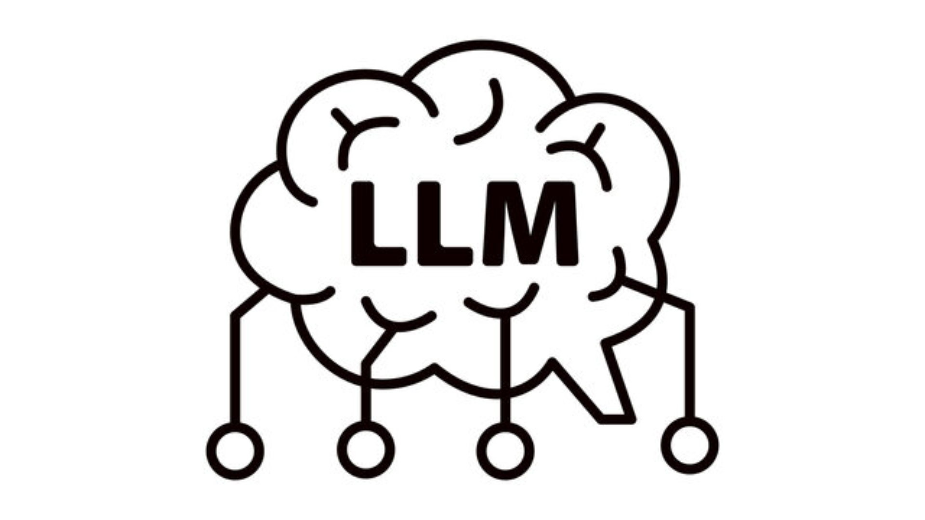

Technologies to be Used
Unity (2023.1.0): AR/VR Environment & 3D Visualization
Python (3.10): Data Processing & API Integration
Django (4.x): Web Interface and Frontend Handling
LLMs (Llama-2-13B-chat.Q4_K_M): Text to Table Conversion
RAG: Visualization Selection (LLM + Retrieval)

Slide 13
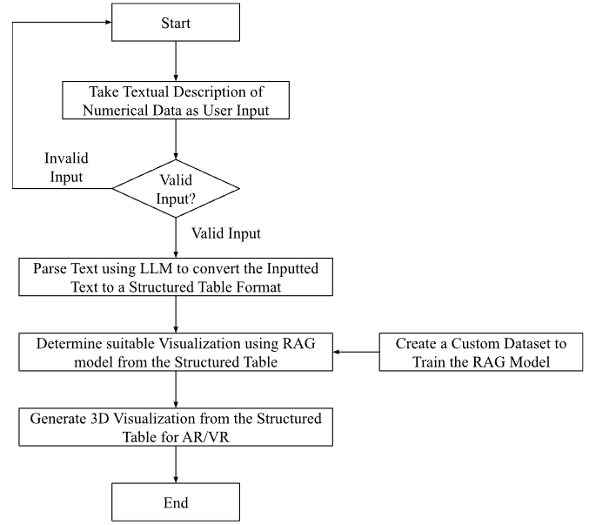
Overview of Implementation
Work Flow Diagram :
Flowchart illustrating the system pipeline, starting from user-provided textual input and progressing through LLM-based table conversion, RAG-based visualization selection, and 3D rendering for AR/VR environments.

Slide 14
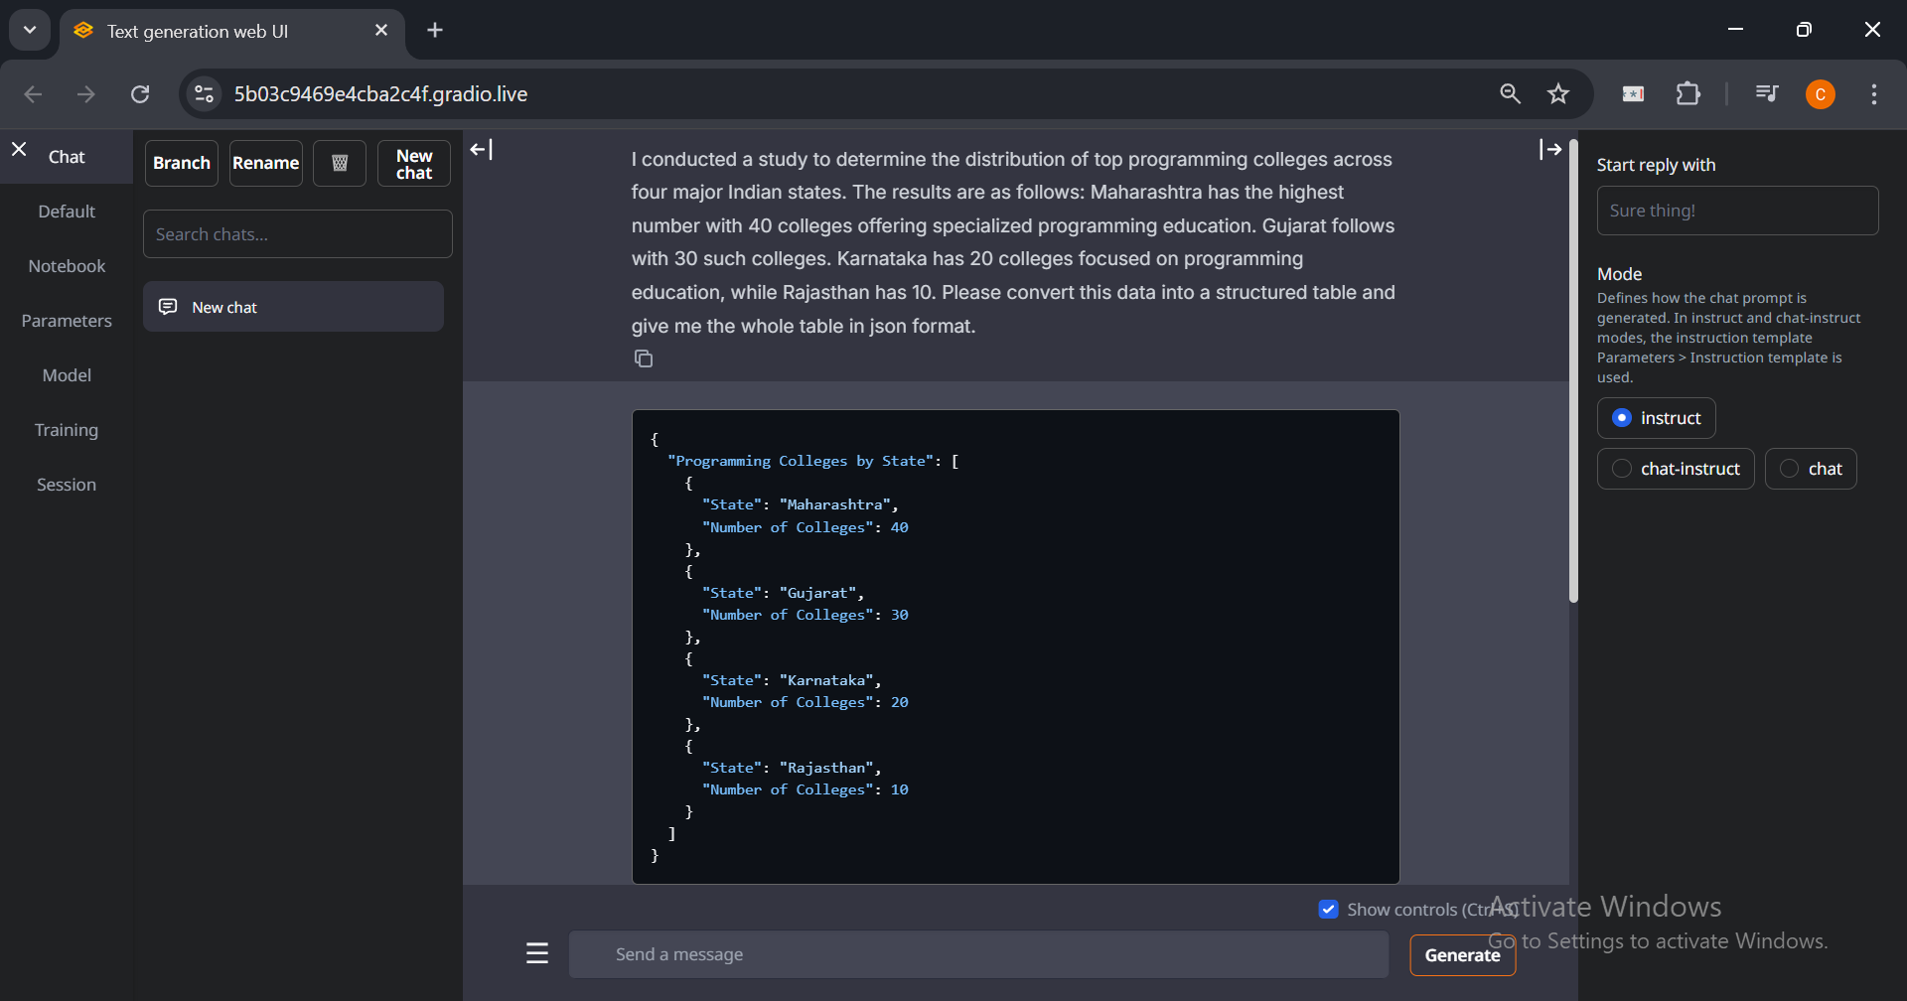
Results and Discussion
The system translates textual data into a structured table (JSON format) using LLM.

Slide 15
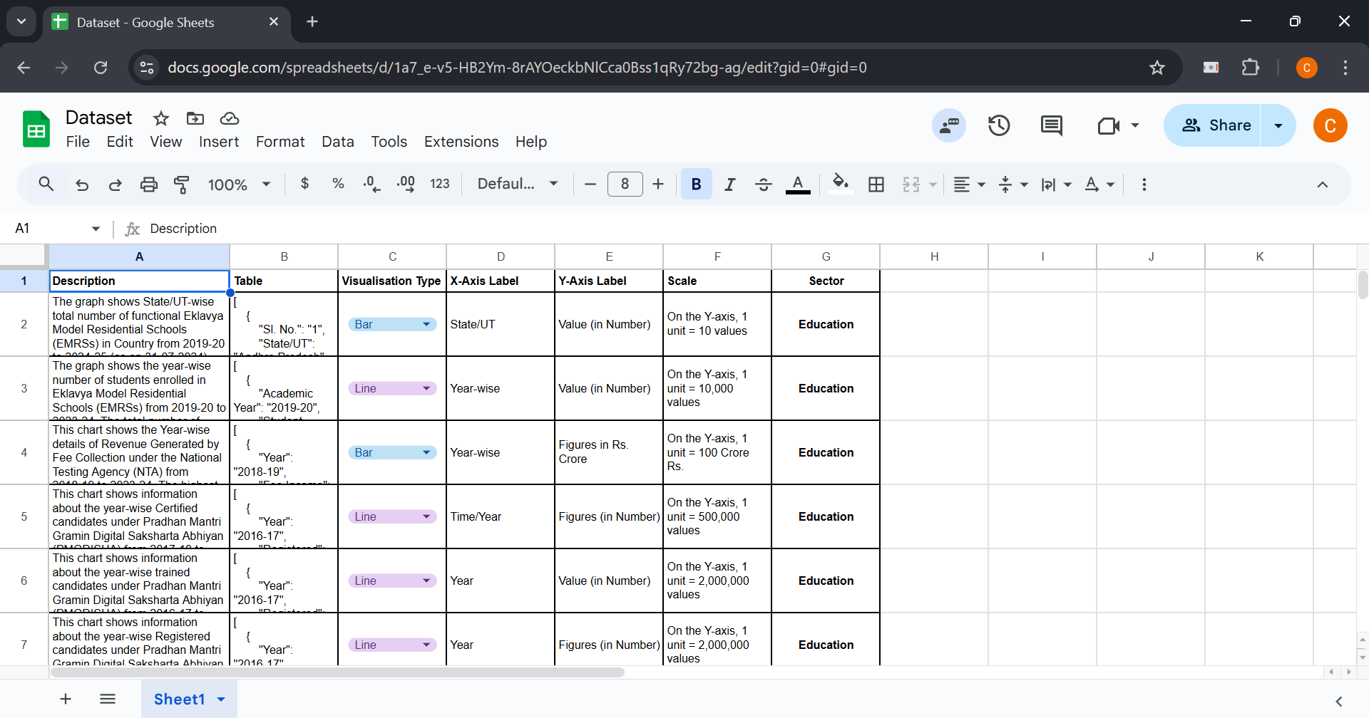
Results and Discussion
A custom dataset was created to train the RAG model, to improve its ability to map structured tabular data to the most relevant visualization type.

Slide 16
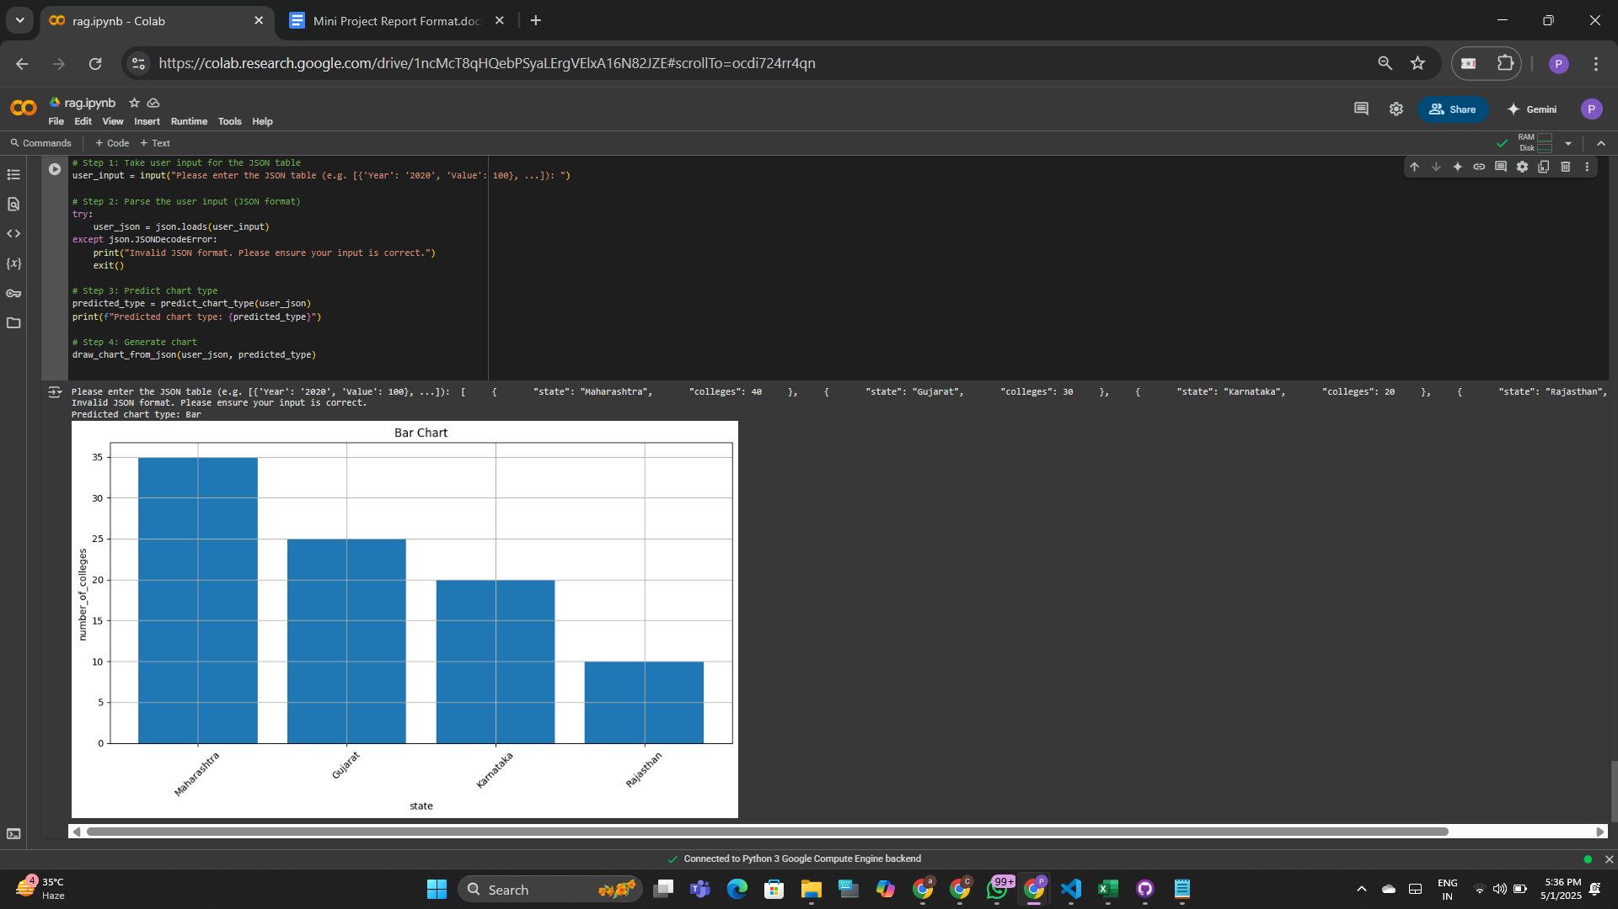
Results and Discussion
The RAG model will effectively predict the most appropriate visualization type based on the data in the table.

Slide 17
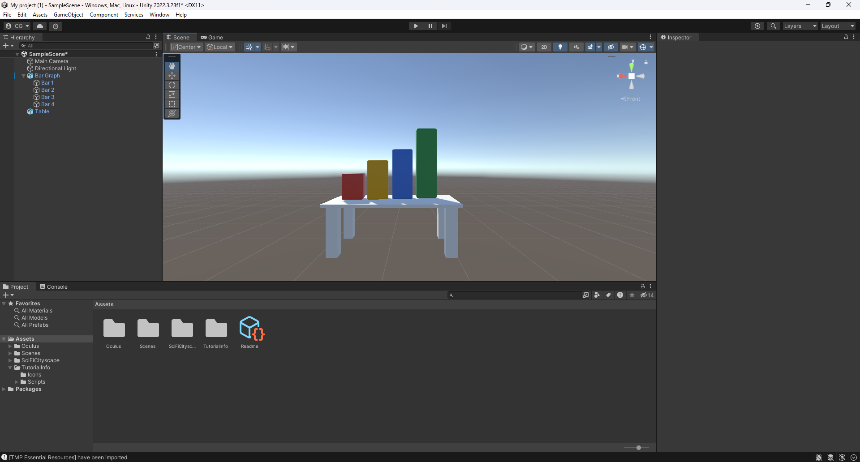
Results and Discussion
The system renders the selected visualizations as immersive 3D models in both Virtual Reality (VR) and Augmented Reality (AR).

Slide 18
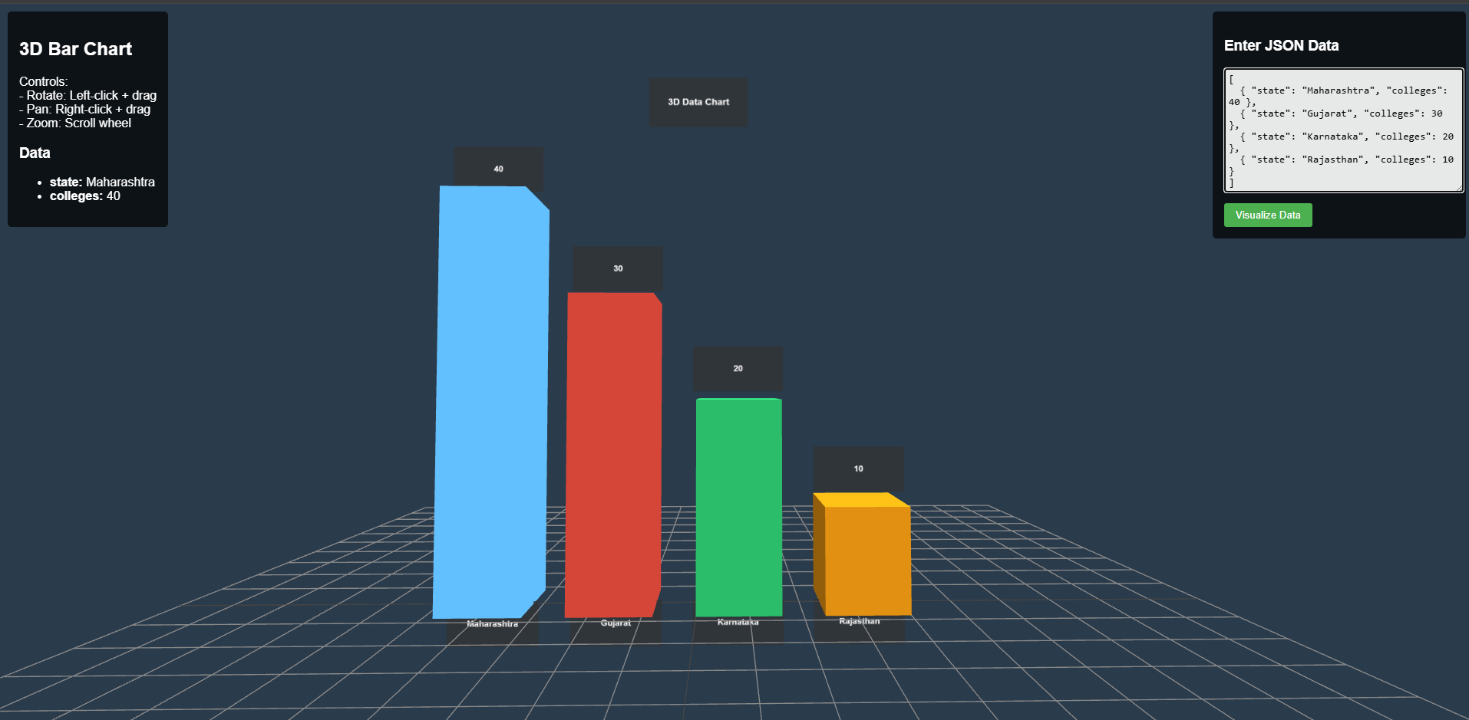
Results and Discussion
In VR, users can zoom, rotate, and pan to explore the visualization.

Slide 19
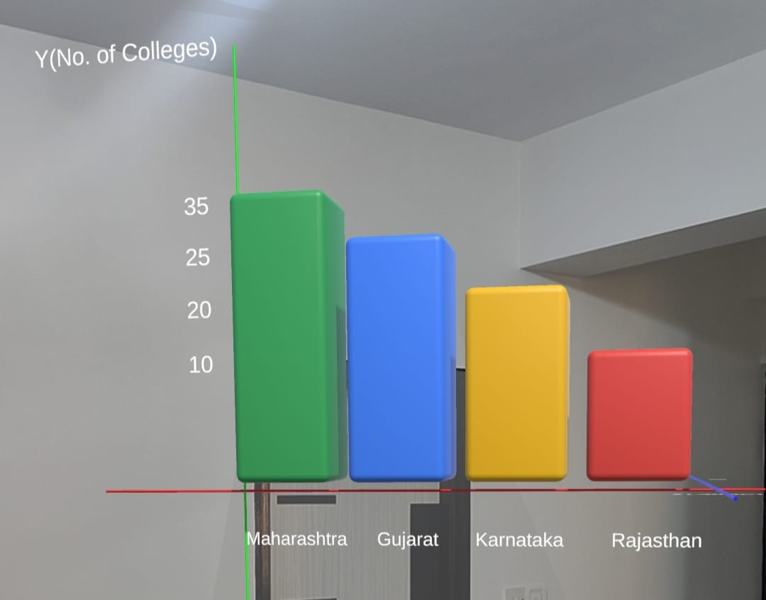
Results and Discussion
In AR, the charts are displayed as static 3D objects within the camera view.

Slide 20
Conclusion and Learnings
Successful visualization of data from textual descriptions.
Improved data exploration with immersive AR/VR environments.
Higher accuracy in visualization selection using a custom dataset.
Potential applications in education, healthcare, and business analytics.

Slide 21
Conclusion and Learnings
LLMs efficiently convert text to structured tables.
3D visualizations rendered in AR/VR environments offer better data interpretation.
RAG model training improves visualization accuracy.
Interactive features enhance user experience.
Real-time data integration and multilingual support are key for future improvements.

Slide 22
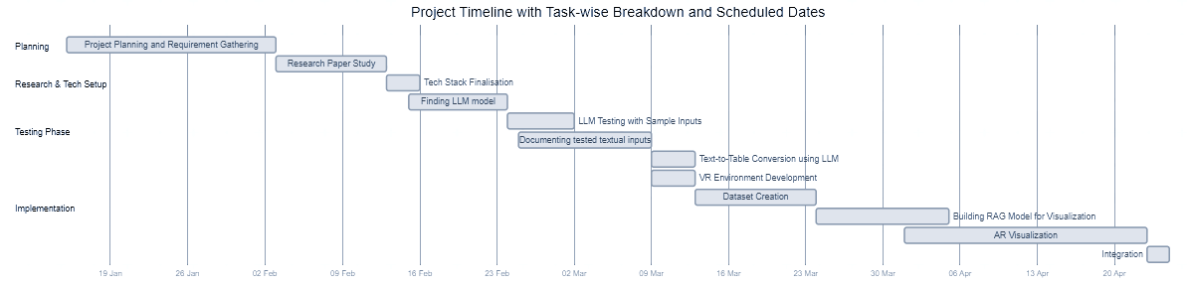
Implementation Schedule

Slide 23
References
S. Coyne and Y. Dong, "Tabularis Revilio: Converting Text to Tables," ACM International Conference on Information and Knowledge Management (CIKM 2024), 2024.
M. Singh, S. Gulwani, V. Le, and G. Verbruggen, "gTBLS: Generating Tables from Text by Conditional Question Answering," arXiv preprint arXiv:2403.14457, 2024.
A. Sundar, C. Richardson, and L. Heck, "Large Language Models as Generalizable Text-to-Table Systems," Proceedings of the Association for Computational Linguistics (ACL 2024), 2024.
Y. Dong, M. Oyamada, C. Xiao, and H. Zhang, "On the Use of Large Language Models for Table Tasks," VLDB/NeurIPS, 2024.
X. Wu, J. Zhang, and H. Li, "Text-to-Table: A New Way of Information Extraction," ACL, 2022.
Z. Guo, J. Zhou, J. Qi, M. Yan, Z. He, X. Wang, and C. Zhou, "Towards Controlled Table-to-Text Generation with Scientific Reasoning," IEEE/Scientific NLP Conference, 2023.
A. H. Huang, H. Wang, and Y. Yang, "FinBERT: A Large Language Model for Extracting Information from Financial Text," Contemporary Accounting Research, vol. 40, no. 2, pp. 806–841, Summer 2023, doi: 10.1111/1911-3846.12832.
P. Kumar, R. Kumar, and A. Gupta, "The Performance of BERT as Data Representation of Text Clustering," Journal of Big Data, 2022.
T. A. Sharma, R. P. Singh, and K. Gupta, "A Survey of Text Representation and Embedding Techniques in NLP," IEEE Access, 2023.
R. Kumar and A. Gupta, "Graph-Based Text Representation and Matching: A Review of the State of the Art and Future Challenges," IEEE Transactions on Knowledge and Data Engineering, 2020.
A. Sharma, R. Patel, and R. Singh, "From Text to Knowledge with Graphs: Modelling, Querying and Exploiting Textual Content," arXiv preprint, 2023.
D. Patel and M. Kumar, "A Novel Multidimensional Reference Model for Heterogeneous Textual Datasets Using Context, Semantic and Syntactic Clues," arXiv preprint, 2023.

